Slide 1

Data Science with Python Estimation of Obesity levels based on Eating habits and Physical Condition Dataset
Team – 11
N. Sai Phani Chandra - 2023000039
K. Geeth Vamsi – 2023000188
K. Chakravarthi – 2023000992
D.S.L Mounika – 2023001320
Notes:
To change the image on this slide, select the picture and delete it. Then click the Pictures icon in the placeholder to insert your own image.

Slide 2
Introduction
Problem Definition
The dataset is focused on analyzing lifestyle and demographic factors to determine their relationship with obesity levels. It involves exploring the impact of various attributes such as eating habits, physical activity, smoking, and other health-related behaviors.
Purpose
The goal is to identify significant predictors of obesity levels and understand patterns that can inform health interventions, policies, or individual lifestyle recommendations.

Slide 3
Introduction
Stakeholders
Healthcare Professionals
Public Health Agencies
Government and Policymakers
Researchers and Data Scientists
General Population

Slide 4
Data Source and Quality
Data Source :
https://archive.ics.uci.edu/dataset/544/estimation+of+obesity+levels+based+on+eating+habits+and+physical+condition
Data Characteristics : Multivariate
Subject Area : Health and Medicine
Number of Instances : 1840
Number of Features : 16
Missing Values : Nil

Slide 5
Descriptive Statistics
Demographics:
Gender: Equal male and female representation ensures unbiased results.
Age: Mean ~25 years (range: 14–61), focusing on young and middle-aged adults.
Physical Attributes:
Height: Mean ~1.7m with low variability.
Weight: Diverse range (42.3–173 kg), mean ~92 kg.
Eating Habits:
FAVC: Binary (yes/no) data links high-calorie food to obesity.
FCVC: Moderate vegetable intake (mean ~2.4/3).
NCP: Most consume 2-3 meals daily (mean ~2.6).

Slide 6
Descriptive Statistics
Lifestyle Factors:
CH2O: Mean ~2.02 liters/day, near the recommended average.
FAF: Infrequent physical activity (mean ~0.97/3).
TUE: Low technology use (~0.63 hours/day).
Obesity Levels:
Clear categories (Normal Weight, Obese) for stratified predictive modeling.

Slide 7
Insights
Individuals with low physical activity and high-calorie diets correlate with higher obesity levels.
Moderate to high water intake and vegetable consumption appear beneficial in maintaining normal weight.
Age and weight show strong influences on obesity, while height contributes minimally.

Slide 8
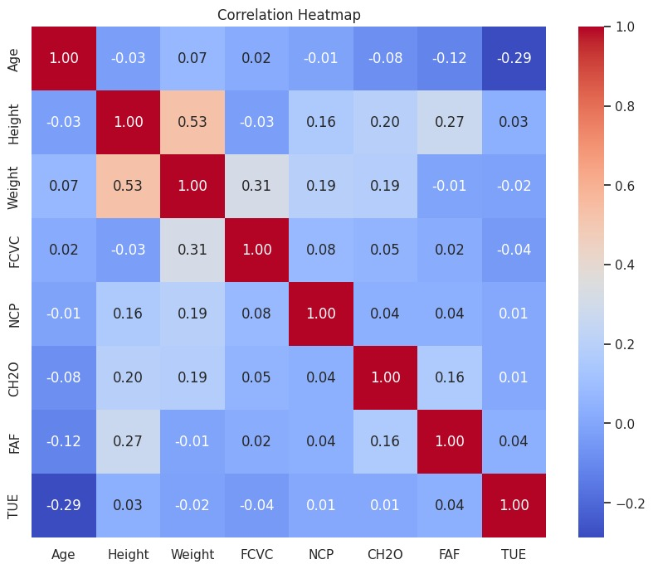
Visualization

Slide 9
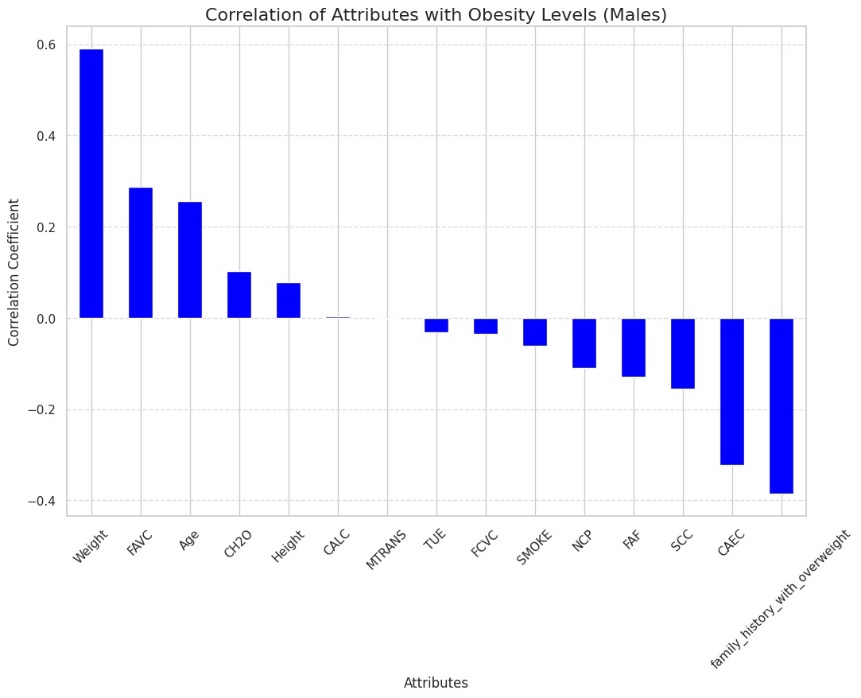
Visualization

Slide 10
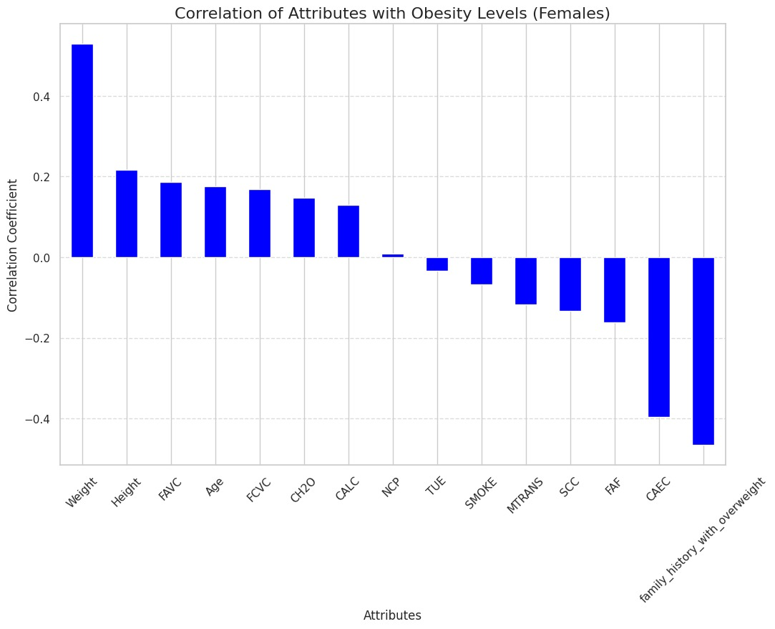
Visualization

Slide 11
Insights
Weight and FAVC (high-calorie food consumption) are the strongest positive predictors of obesity in both genders, emphasizing the role of diet and body mass.
Family history with overweight and CAEC (carbonated/alcoholic drink consumption) are significant negative predictors, indicating healthier behaviors or lower genetic predisposition.
Males show slightly higher correlations for some attributes, but overall trends are similar across genders.
Height, Weight, and physical activity are notable factors, but most variable relationships are weak, reflecting the complex nature of obesity determinants.

Slide 12
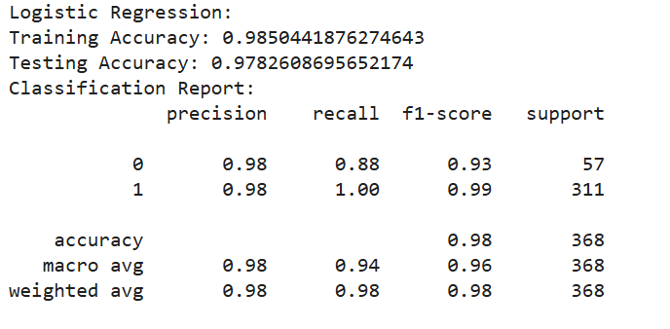
Models

Slide 13
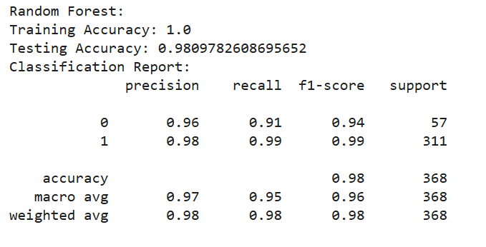
Models

Slide 14
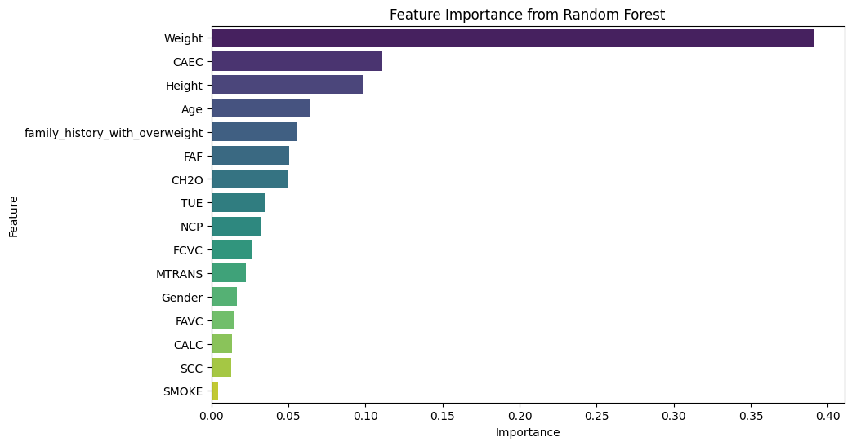
Visualization
CAEC : Do you eat any food between meals?
FAF : How often do you have physical activity?
NCP: How many main meals do you have daily?
TUE: How much time do you use technological devices such as cell phone, videogames, television, computer and others?
FCVC : Do you usually eat vegetables in your meals?
MTRANS : Which transportation do you usually use?
FAVC : Do you eat high caloric food frequently?

Slide 15
Insights
Both models perform similarly on testing data (Random Forest: 0.981, Logistic Regression: 0.978).
Random Forest has higher recall for Class 0 (0.91 vs. 0.88) but slightly lower precision (0.96 vs. 0.98).
Logistic Regression achieves perfect recall (1.00) for Class 1 but underperforms for Class 0.
Random Forest shows perfect training accuracy (1.0), indicating potential overfitting.
Logistic Regression generalizes slightly better with a training accuracy of 0.985.
Random Forest is more complex and computationally expensive.
Logistic Regression is simpler and more interpretable.

Slide 16
Conclusion
Weight, physical activity (FAF), and eating habits strongly impact obesity.
Family history and transportation choices also play a role.
Random Forest performed better, handling complex patterns effectively.
Logistic Regression provided a simple but less effective baseline.
Focus areas include promoting physical activity, healthy eating, and awareness for those with a family history of obesity.

Slide 17
Future Work
Fine-tune hyperparameters (like for Random Forest) and explore advanced models like Gradient Boosting or Neural Networks.
Create new features (like BMI, diet diversity scores) and analyze cultural or regional influences on obesity.
Add detailed data (like diet, physical activity, sleep) and collect longitudinal data for trend analysis.
Build predictive tools for personalized health advice and guide public health campaigns targeting specific risk factors.

Slide 18
THANK YOU
Notes:
To change the image on this slide, select the picture and delete it. Then click the Pictures icon in the placeholder to insert your own image.

